Slide 1
India – China Relationship
India and China have never had common political doctrines or organizational concepts; right from ancient times.
The Panchsheel agreement or the Five Principles of Peaceful Co-existence was signed in April 1954 between India and China. (Zhou Enlai)
The Five Principles are:
1.mutual respect for sovereignty and territorial integrity,
2.mutual non-aggression,
3.non-interference in each other's internal affairs,
4. equality and mutual benefit,
5. peaceful co-existence.
Panchsheel was a sensible idea for India and China to disengage from each other's internal affairs

Slide 2
Reasons for Dispute Border Dispute :
Aksai Chin area in Kashmir.( Eastern Front)
Claim over NEF (Arunchal Pradesh)
Issue of Tibet
China refuses to acknowledge the MacMahon Line
Beijing argued there was no demarcated boundary between India and China along the Himalayan Ridges.
But New Delhi stick to McMohan Lines.
Nehru’s Government granted Dalai Lama asylum in India in 1959.
This is argued for the main reasons for China aggresion over India.

Slide 3
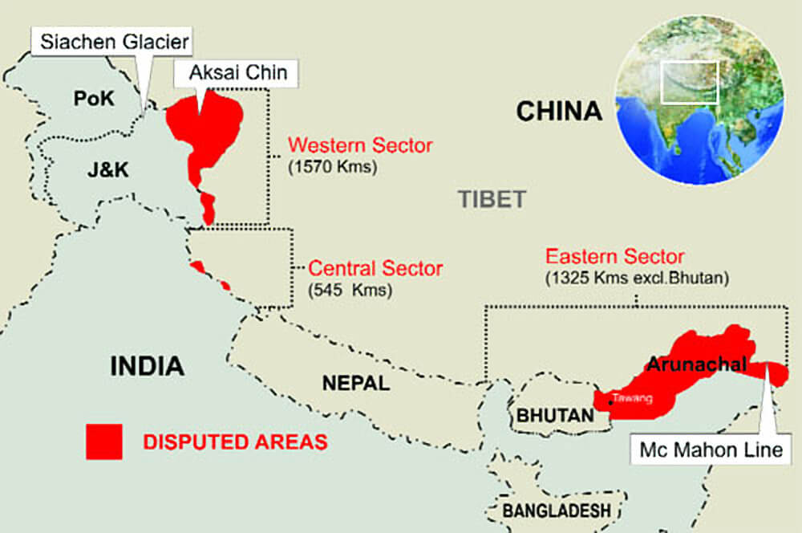

Slide 4
Border dispute led to a full- scale war in 1962 and armed skirmishes in 1967 and 1987.
Indo- China war 1962
In October – war was faught -Indian army debacle- after securing victory – Beijing unilaterally declared a ceasefire
2017 Doklam standoff
Doklam, a territory which is claimed by both China as well as India's ally Bhutan

